Slide 1
Superscalar and VLIW Architectures
Miodrag Bolic
CEG3151

Slide 2
Outline
Types of architectures
Superscalar
Differences between CISC, RISC and VLIW
VLIW
EPIC
Superpipelined architectures

Slide 3
Parallel processing [2]
Processing instructions in parallel requires three major tasks:
checking dependencies between instructions to determine which instructions can be grouped together for parallel execution;
assigning instructions to the functional units on the hardware;
determining when instructions are initiated placed together into a single word.

Slide 4
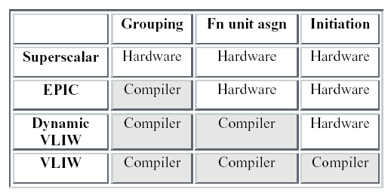
Major categories [2]
VLIW – Very Long Instruction Word
EPIC – Explicitly Parallel Instruction Computing
From Mark Smotherman, “Understanding EPIC Architectures and Implementations”

Slide 5
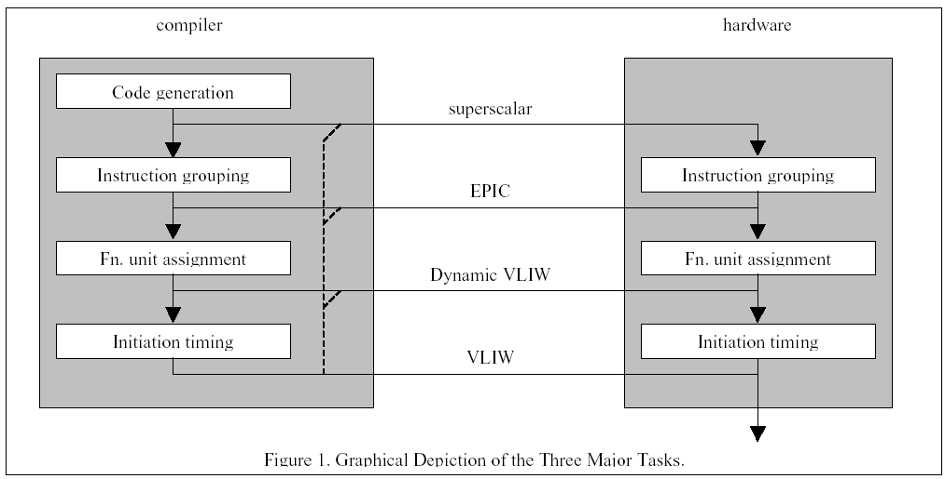
Major categories [2]
From Mark Smotherman, “Understanding EPIC Architectures and Implementations”

Slide 6
Superscalar Processors [1]
Superscalar processors are designed to exploit more instruction-level parallelism in user programs.
Only independent instructions can be executed in parallel without causing a wait state.
The amount of instruction-level parallelism varies widely depending on the type of code being executed.

Slide 7
Pipelining in Superscalar Processors [1]
In order to fully utilise a superscalar processor of degree m, m instructions must be executable in parallel. This situation may not be true in all clock cycles. In that case, some of the pipelines may be stalling in a wait state.
In a superscalar processor, the simple operation latency should require only one cycle, as in the base scalar processor.

Slide 8
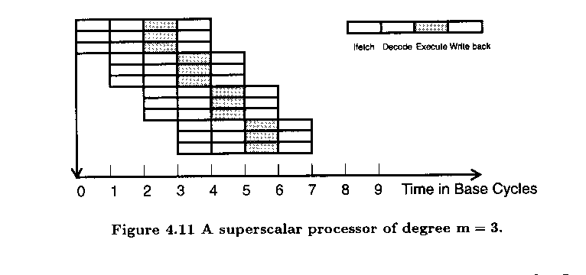

Slide 9
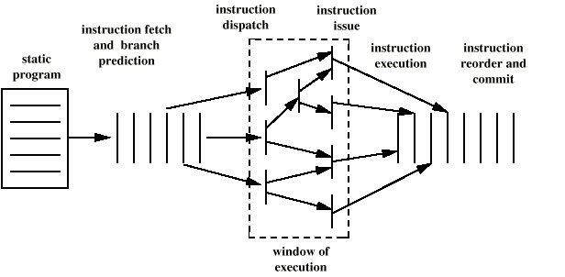
Superscalar Execution

Slide 10
Superscalar Implementation
Simultaneously fetch multiple instructions
Logic to determine true dependencies involving register values
Mechanisms to communicate these values
Mechanisms to initiate multiple instructions in parallel
Resources for parallel execution of multiple instructions
Mechanisms for committing process state in correct order

Slide 11
Some Architectures
PowerPC 604
  six independent execution units:
    Branch execution unit
    Load/Store unit
    3 Integer units
    Floating-point unit
  in-order issue
  register renaming
Power PC 620
  provides in addition to the 604 out-of-order issue
Pentium
  three independent execution units:
    2 Integer units
    Floating point unit
  in-order issue

Slide 12
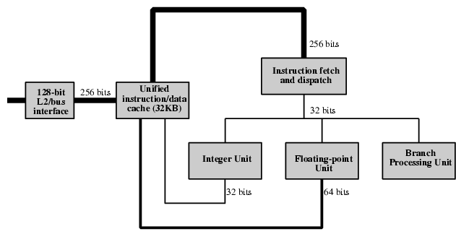
PowerPC 601 General View

Slide 13
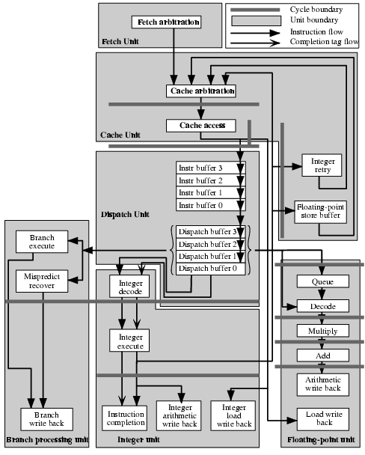
PowerPC 601
Pipeline
Structure

Slide 14
The VLIW Architecture [4]
A typical VLIW (very long instruction word) machine has instruction words hundreds of bits in length.
Multiple functional units are used concurrently in a VLIW processor.
All functional units share the use of a common large register file.

Slide 15
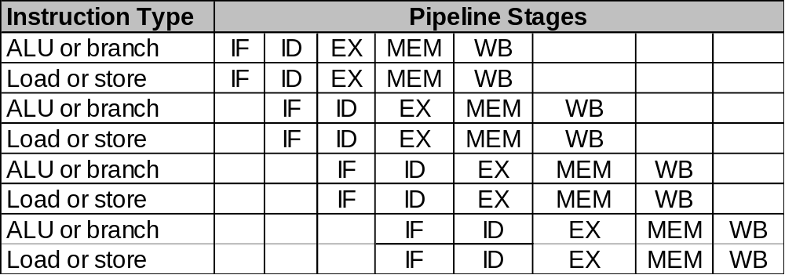
Static two-issue pipeline (1) [7]
Assuming that two instructions are launched per clock cycle
  One ALU or branch and the other is a memory reference
Have to decode 64 bits rather than 32 bits
  Could ensure that the instructions are on 64-bit boundaries with ALU/branch coming first
  Could dynamically decide which instruction goes to which part of the datapath

Slide 16
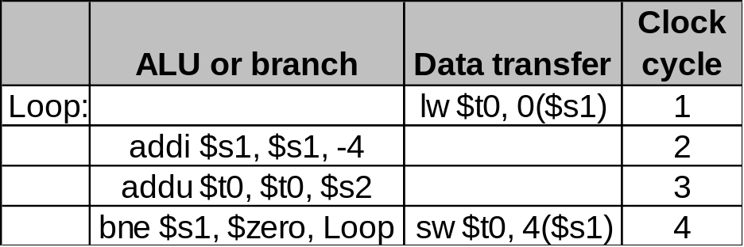
Static two-issue pipeline (2) [7]
In order to support multiple instruction launches, we need
  Two extra read ports on the register file (two registers for ALU operation + two registers for store instruction)
  One extra write port (one for ALU operation + one for load instruction)
  One extra adder (one for ALU + one for address calculation)
Code scheduling could be required to avoid pipeline stalling
Loop: lw $t0, 0($s1)
addu $t0, $t0, $s2
sw $t0, 0($s1)
addi $s1, $s1, -4
bne $s1, $zero, Loop

Slide 17
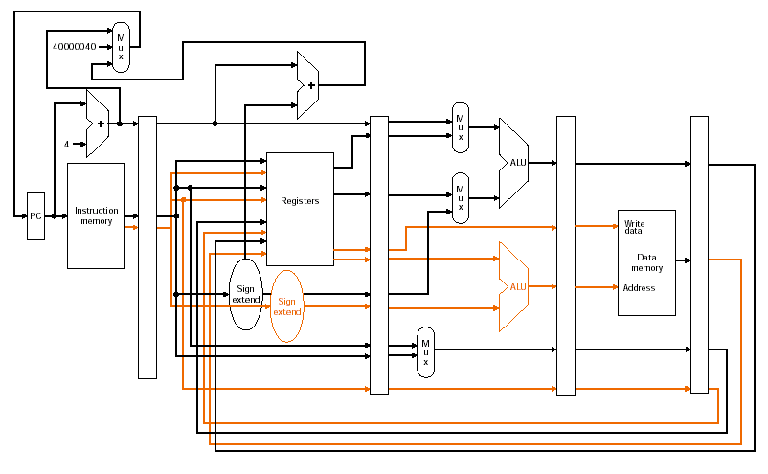
Static two-issue pipeline (3) [7]

Slide 18
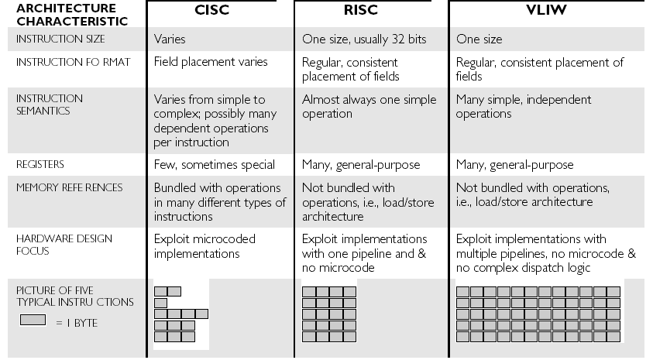
Comparison: CISC, RISC, VLIW [4]

Slide 19
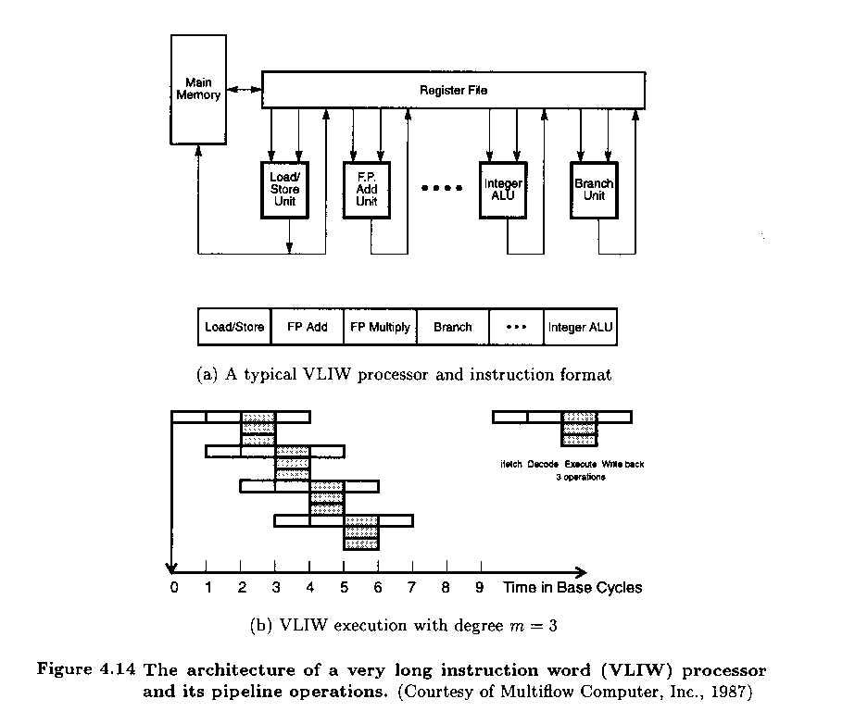

Slide 20
Advantages of VLIW
Compiler prepares fixed packets of multiple operations that give the full "plan of execution"
  dependencies are determined by compiler and used to schedule according to function unit latencies
  function units are assigned by compiler and correspond to the position within the instruction packet ("slotting")
  compiler produces fully-scheduled, hazard-free code => hardware doesn't have to "rediscover" dependencies or schedule

Slide 21
Disadvantages of VLIW
Compatibility across implementations is a major problem
  VLIW code won't run properly with different number of function units or different latencies
  unscheduled events (e.g., cache miss) stall entire processor
Code density is another problem
  low slot utilization (mostly nops)
  reduce nops by compression ("flexible VLIW", "variable-length VLIW")

Slide 22
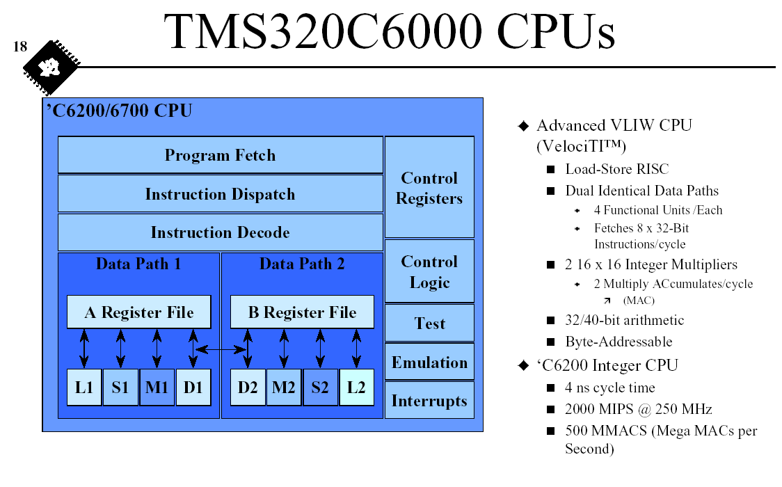

Slide 23
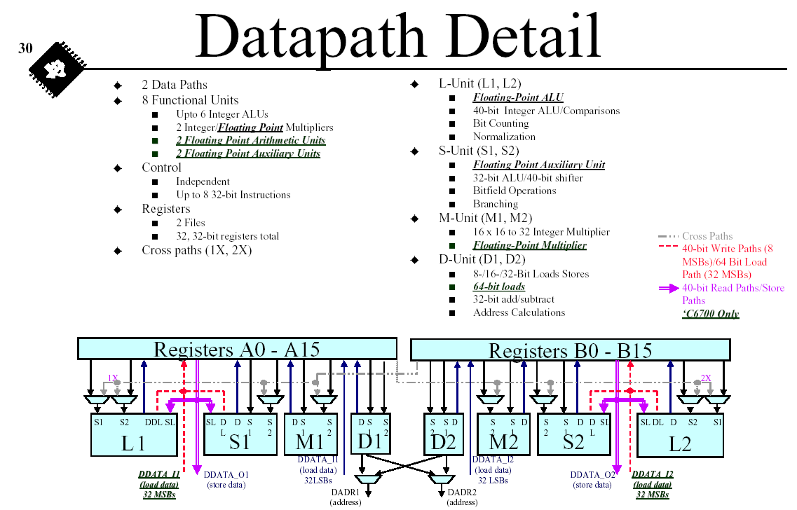

Slide 24
Superpipeline architectures [1]
Degree n; pipeline cycle is 1/n
Issue rate=1, issue latency 1/n
Require high-speed clocking

Slide 25
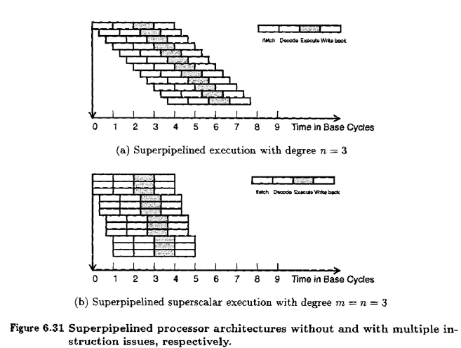

Slide 26
Comparison of superscalar and superpipelined architectures [1]
Superscalar
Depends on spatial parallelism
More transistors
Superpipelined
Depends on temporal parallelism
Faster transistors
Design must minimize effects of clock skewing

Slide 27
References
Advanced Computer Architectures, Parallelism, Scalability, Programmability, K. Hwang, 1993.
M. Smotherman, "Understanding EPIC Architectures and Implementations" (pdf) http://www.cs.clemson.edu/~mark/464/acmse_epic.pdf
Lecture notes of Mark Smotherman, http://www.cs.clemson.edu/~mark/464/hp3e4.html
An Introduction To Very-Long Instruction Word (VLIW) Computer Architecture, Philips Semiconductors, http://www.semiconductors.philips.com/acrobat_download/other/vliw-wp.pdf
Lecture 6 and Lecture 7 by Paul Pop, http://www.ida.liu.se/~TDTS51/
Texas Instruments, Tutorial on TMS320C6000 VelociTI Advanced VLIW Architecture. http://www.acm.org/sigs/sigmicro/existing/micro31/pdf/m31_seshan.pdf
Morgan Kaufmann Website: Companion Web Site for Computer Organization and Design

